Slide 1
An Update from the NYSED Office of Curriculum & Instruction
October 2015
Sue Brockley, Mathematics Assistant
John Svendsen, Mathematics Associate
EngageNY.org

Slide 2
What is New ?
Presidential Awards
Fluency Supplement for Grades 6-8
Coherence Maps and mini assessments for Grades K-8
Performance Level Descriptors for Geometry
Transition to the Regents Examination in Algebra II Common Core Memo August 2015
(This proposed amendment will be presented to the Regents for adoption in December.)

Slide 3
Algebra II
END
OF THE
ROAD
New
Mathematical
Beginnings
College
Career
Ready
Polynomial, Rational,
Radical Relationships
Trig functions
Functions
Inferences and Conclusions
from Data
The Algebra II Regents Examination

Slide 4
Probability and Statistics
Analysis of one variable quantitative data (one set of data)
Measures of Center: Mean and Median (which is a better center) , quartiles, IQR
Measures of Spread: MAD (Mean Absolute Deviation, how far are each of the data points on average)
Displays: Dot plots, Histogram, Box Plots and analysis of shape (clusters, peaks, gaps, patterns)
6 th grade
Comparing two populations (comparative box plots)
Random sampling (simulation)
Sampling distribution of sample proportions
Sampling variability and the effect of sample size
Using variability when estimating a population proportion.
Introduction to probability/ chance processes and probability models
Sample space
Using tree diagrams to calculate probabilities (counting principle, and , or , not)
Calculating probabilities of compound events (relative frequency vs. theoretical)
7 th grade
Investigating patterns of association in bivariate data
Scatter Plots and fitting a line to data
Determining the equation of a line
Summarizing data in a two-way table
Association between 2 categorical variables
8 th grade
Describing center, shape and variability including standard deviation
Two-way tables and conditional relative frequencies
Modeling relationships with a line (formal)
Analysis of residual plots
Interpreting the correlation coefficient
Algebra I

Slide 5
Have they heard these terms…
Data – numerical /categorical
Chance experiment/outcomes
Sample space
Counting principle
Tree diagram
Event
Complement
Intersection
Union
Mutually exclusive
Venn Diagrams
Independent/dependent events
Association
Conditional Relative Frequency

Slide 6
High School - Statistics & Probability
Conditional Probability and the Rules of Probability (S-CP)
Understand independence and conditional probability and use them to interpret data. (Additional)
S-CP.A.1 Describe events as subsets of a sample space (the set of outcomes) using characteristics (or categories) of the outcomes, or as unions, intersections, or complements of other events (“or,” “and,” “not”).
S-CP.A.2 Understand that two events A and B are independent if the probability of A and B occurring together is the product of their probabilities, and use this characterization to determine if they are independent.
S-CP.A.3 Understand the conditional probability of A given B as P(A and B)/P(B), and interpret independence of A and B as saying that the conditional probability of A given B is the same as the probability of A, and the conditional probability of B given A is the same as the probability of B.
S-CP.A.4 Construct and interpret two-way frequency tables of data when two categories are associated with each object being classified. Use the two-way table as a sample space to decide if events are independent and to approximate conditional probabilities. For example, collect data from a random sample of students in your school on their favorite subject among math, science, and English. Estimate the probability that a randomly selected student from your school will favor science given that the student is in tenth grade. Do the same for other subjects and compare the results.
S-CP.A.5 Recognize and explain the concepts of conditional probability and independence in everyday language and everyday situations. For example, compare the chance of having lung cancer if you are a smoker with the chance of being a smoker if you have lung cancer.
B. Use the rules of probability to computer probabilities of compound events in a uniform probability model. (Additional)
S-CP.B.6 Find the conditional probability of A given B as the fraction of B’s outcomes that also belong to A, and interpret the answer in terms of the model.
S-CP.B.7 Apply the Addition Rule, P(A or B) = P(A) + P(B) – P(A and B), and interpret the answer in terms of the model.

Slide 7
Complement Rule
If the event is denoted by A, then this rule can be written:
P(not A)=1-P(A)
Conditional Probability Rule
The formula for conditional probability is
P(A given B)= P(A and B)
P(B)
Two events A and B are said to be independent if
P(A given B)=P(A) and P(B given A)=P(B)
Multiplication Rule for Independent Events
P(A and B) = P(A) * P(B)
Addition Rule
P(A or B) = P(A) + P(B) – P(A and B)
Disjoint Events
Two events are disjoint if they have no outcomes in common. P(A or B) = P(A) + P(B)

Slide 8
Quiz Scenario: Student answers 4 (true/false) questions on a quiz…
P(exactly 2 correct answers) = 6/16
P(C on first question)=8/16=1/2
P(C on second question)=8/16=1/2
P(C on first and C on second) = 4/16=1/4
= ½ x ½
This shows that the two events (C on first question) and (C on second question) are independent, by the definition of independence. P(A and B) = P(A) * P(B)
This, too, should seem intuitively reasonable to students because the random guess on the second question should not have been influenced by the random guess on the first.
16 Outcomes
CCCC
CCCI
CCIC
CICC
ICCC
CCII
CIIC
IICC
CICI
ICIC
ICCI
CIIII
ICIII
IICI
IIIC
IIII
P(C on second question/C on first)=
4/8 = ½= P(C on second question)
http://ime.math.arizona.edu/progressions

Slide 9
Leader Scenario: Choosing 2 students from 5, (3 girls and 2 boys) First will be discussion leader, second will be the recorder.
Dependence: Selection of recorder depends on the selection of the leader.
P(girl on second)= 3/5 .
So, these two events are again seen to be dependent. The outcome of the second draw does depend on what happened at the first draw.
http://ime.math.arizona.edu/progressions

Slide 10
A traveler estimates that, for an upcoming trip, the probability of catching malaria is 0.18, the probability of catching typhoid is 0.13, and the probability of catching neither of the two diseases is 0.75.
Construct a two-way table
Draw a Venn diagram to represent this information.
Calculate the probability of catching both of the diseases.
Are the events catches malaria and catches typhoid independent? Explain your answer.

Slide 11
Two-way Table (Hypothetical 1000)
P(M)=0.18
P(T)=0.13
P(neither)=0.75
What is P (M and T) ?
$$\frac{60}{1000}$$
 | Catch Typhoid | Don’t Catch Typhoid | Totals
Catch Malaria |  |  | 180
Don’t catch Malaria |  | 750
Totals | 130 |  | 1000
60
120
70
820
870
Venn Diagram
Using the addition rule…
1-0.75=0.25 = M $∪$ T
0.18+0.13=0.31-0.25= 0.06 = M $∩$ T
M
T
0.06
Are the events catches malaria and catches typhoid independent? Explain your answer.
0.07
0.12
P(M/T)= 60/130
P(M)= 180/1000
P(T/M)= 60/180
P(T)=130/1000
P($M∩$ T) =0.06 which is not equal to
P(M) $×$ P(T)= (0.18) x (0.13) = 0.0234
0.75
No…because …

Slide 12
On April 15, 1912, the Titanic struck an iceberg and rapidly sank with only 710 of her 2,204 passengers and crew surviving. Some believe that the rescue procedures favored the wealthier first class passengers. Data on survival of passengers are summarized in the table below. We will use this data to investigate the validity of such claims. (Data source www.encyclopedia-titanica.org/titanic -statistics.
 | Survived | Did not survive | Total
First class passengers | 201 | 123 | 324
Second class passengers | 118 | 166 | 284
Third class passengers | 181 | 528 | 709
Total passengers | 500 | 817 | 1317
Are the events “passenger survived” and “passenger was in first class” independent events? Support your answer using appropriate probability calculations.
P(S/F) = $\frac{201}{324}$
P(S)=$\frac{500}{1317}$
Are the events “passenger survived” and "passenger was in third class” independent events? Support your answer using appropriate probability calculations.
P(S/T)=$\frac{181}{709}$
Did all passengers aboard the Titanic have the same probability of surviving? Support your answer using appropriate probability calculations.
P(S/SC)=$\frac{118}{284}$
Chance of surviving depended on class.

Slide 13
Algebra II Sample
Item
 | Insurance Agreement | No Insurance Agreement | Total
Salary Agree |  |  | 0.50
No Salary Agree |  | 0.20 | 0.50
Total | 0.70 | 0.30 | 1
0.40
0.10
0.30

Slide 14
High School - Statistics & Probability
Interpreting categorical and quantitative data (S-ID)
Summarize, represent, and interpret data on a single count or measurement variable. (Additional)
S-ID.A.4 Use the mean and standard deviation of a data set to fit it to a normal distribution and to estimate population percentages. Recognize that there are data sets for which such a procedure is not appropriate. Use calculators, spreadsheets, and tables to estimate areas under the normal curve.
B. Summarize, represent, and interpret data on two categorical and quantitative variables. (Supporting)
S-ID.B.6 Represent data on two quantitative variables on a scatter plot, and describe how the variables are related. a. Fit a function to the data; use functions fitted to data to solve problems in the context of the data. Use given functions or choose a function suggested by the context. Emphasize linear, quadratic, and exponential models. (Shared with A1)
PARCC: i) Tasks have a real-world context. ii) Tasks are limited to exponential functions with domains not in the integers and trigonometric functions.

Slide 15
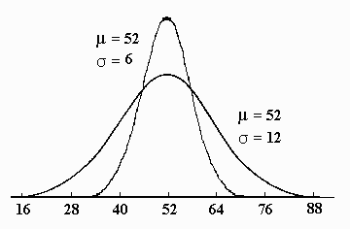
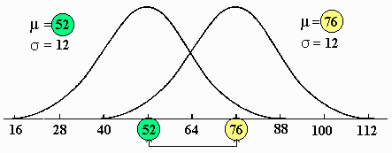
Standard Deviation: How far from normal…
Algebra I…understand how changes in the mean and the standard deviation affect the position and shape of the distribution. (skewed, symmetric)
The Empirical Rule in Algebra II
(68-95-99.7)
© Texas Instruments Incorporated
Normal Curve Application. TEACHER NOTES. TIMATH.COM: STATISTICS. ©

Slide 16
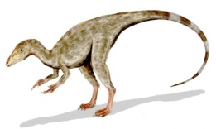
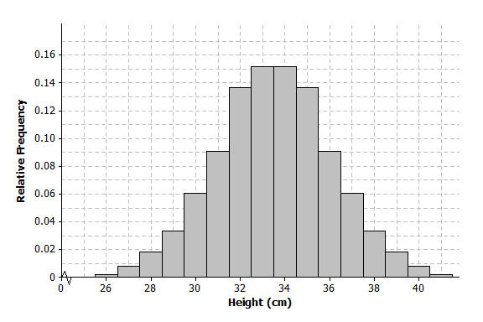
Lesson 9 Example
A paleontologist studies prehistoric life and sometimes works with dinosaur fossils. The table below shows the distribution of heights (rounded to the nearest inch) of 660 procompsognathids or “compys.”
The heights were determined by studying the fossil remains of the compys.
Distribution of Heights to Compys
What does the relative frequency of 0.136 mean for the height of 32 cm?
What is the width of each bar? What does the height of the bar represent?
What is the area of the bar that represents the relative frequency for compys with a height of 32 cm?
The mean of the distribution of compy heights is 33.5 cm, and the standard deviation is 2.56 cm. Interpret the mean and standard deviation in this context.

Slide 17
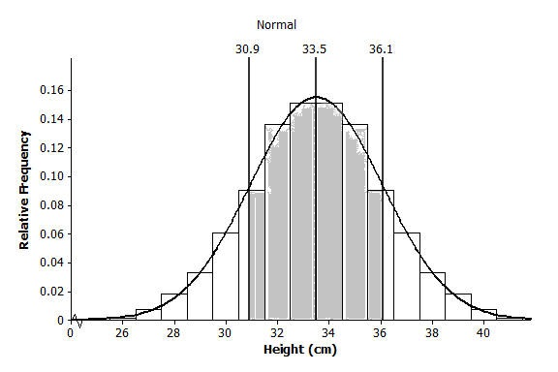
Mark the mean on the graph and mark one deviation above and below the mean.
Approximately what percent of the values in this data set are within one standard deviation of the mean? (i.e., between 33.5-2.56=30.94 cm and 33.5+2.56=36.06 cm.)
Approximately what percent of the values in this data set are within two standard deviations of the mean?
Draw a smooth curve that comes reasonably close to passing through the midpoints of the tops of the bars in the histogram. Describe the shape of the distribution.
Shade the area under the curve that represents the proportion of heights that are within one standard deviation of the mean.
www.mathsisfun.com
Notes:
Answer on the next slide

Slide 18
Work with Empirical Rule: 68-95-97.7
55
60
65
70
75
80
85
http://teachers.henrico.k12.va.us/freeman/conway_b/Files/AP%20Stat/Unit3.Day1.Answers.pdf

Slide 19
Introduction to Z score
Suppose that you took a math test and a Spanish test. The mean score for both tests was 80. You got an 86 in math and a 90 in Spanish. Did you necessarily do better in Spanish relative to your fellow students?
Suppose the standard deviation of the math scores was 4 and the standard deviation of the Spanish scores was 8. Then my score of 86 in math is 1.5 standard deviations above the mean, and my score in Spanish is only 1.25 standard deviations above the mean. Relative to the other students, I did better in math.
A z score for a particular value measures the number of standard deviations away from the mean. A positive z score corresponds to a value that is above the mean, and a negative z score corresponds to a value that is below the mean. The letter z was used to represent a variable that has a standard normal distribution where the mean is 0 and standard deviation is 1. This distribution was used to define a z score.
A z score is calculated by
Z = value-mean
standard deviation.
Notes:
Might help to draw a picture
Math Spanish
| | | | | |
___________________________ ____________________________
80 81 82 83 84 85 86 80 81 82 83 84 85 86 87 88 89 90
Use the diagram and explain the value of 1.5 and 1.25

Slide 20
Lesson 10: Using z scores and the graphing calculator to find normal probabilities
A swimmer named Amy specializes in the 50 meter backstroke. In competition her mean time for the event is 39.7 seconds, and the standard deviation of her times is 2.3 seconds. Assume that Amy’s times are approximately normally distributed.
Make a sketch.
Estimate the probability that Amy’s time is between 37 and 44 seconds
Calculate z scores
Use graphing calculator, find the probability that Amy’s time in her next race is between 37 and 44 seconds
Notes:
Answers next 2 slides

Slide 21
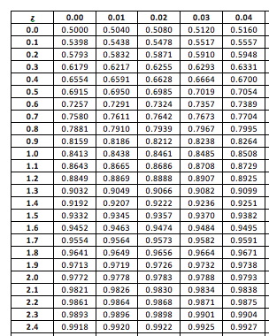
Standard Normal table
Normalcdf (37,44,39.7, 2.3)=.849
37 39.7 44
Calculate z scores
The z score for 44 is 44-39.7=4.3/2.3$≈$1.870, and the z score for 37 is 37-39.7=-2.7/2.3$≈$-1.174
Normalcdf(-1.174,1.870)=.849
https://www.illustrativemathematics.org/content-standards/HSS/ID/A/4/tasks

Slide 22
High School - Statistics & Probability
Making Inferences and Justifying Conclusions (S-IC)
Understand and evaluate random processes underlying statistical experiments. (Supporting)
S-IC.A.1 Understand statistics as a process for making inferences about population parameters based on a random sample from that population.
S-IC.A.2 Decide if a specified model is consistent with results from a given data-generating process, e.g., using simulation. For example, a model says a spinning coin falls heads up with probability 0.5. Would a result of 5 tails in a row cause you to question the model?
B. Make inferences and justify conclusions from sample surveys, experiments, and observational studies. (Major)
S-IC.B.3 Recognize the purposes of and differences among sample surveys, experiments, and observational studies; explain how randomization relates to each.
S-IC.B.4 Use data from a sample survey to estimate a population mean or proportion; develop a margin of error through the use of simulation models for random sampling.
S-IC.B.5 Use data from a randomized experiment to compare two treatments; use simulations to decide if differences between parameters are significant.
S-IC.B.6 Evaluate reports based on data.

Slide 23
What progressions tell us…
Surveys of samples to estimate population parameters, experiments to compare treatments and show cause, and observational studies to indicate possible associations among variables are the three main methods of data production in statistical studies. Students should understand the distinctions among these three and practice perceiving them in studies that are reported in the media, deciding if appropriate inferences seem to have been drawn.
Types of Statistical Studies: Observational, survey and experiment. Students must know the purpose and limitations of each type.
An observational study records the values of variables for members of a sample. There are several types of observational studies. Observational studies are designed to observe subjects as they are, without any manipulation by the researcher.
A survey is a type of observational study that gathers data by asking people a number of questions.
An experiment assigns subjects to treatments to see what effect the treatments have on some response.

Slide 24
Students see Random sampling as the key that allows the computation of margins of error in estimating a population quantity.
A population is the entire set of subjects in which there is an interest.
A sample is a part of the population from which information (data) is gathered, often for the purpose of generalizing from the sample to the population.
A summary measure calculated using all the individuals in a population is called a population characteristic. A population proportion and a population mean are two examples of population characteristics.
If the summary measure is calculated using data from a random sample, it is called a sample statistic. For example, a sample proportion or a sample mean are sample statistics.
Random sample is one that gives every different possible sample an equal chance to be chosen.

Slide 25
Grade 7 Module 5 Topic C Random Sampling and Estimating Population Characteristics
7.SP.A.1 Understand that statistics can be used to gain information about a population by examining a sample of the population; generalizations about a population from a sample are valid only if the sample is representative of that population. Understand that random sampling tends to produce representative samples and support valid inferences.
7.SP.A.2 Use data from a random sample to draw inferences about a population with an unknown characteristic of interest. Generate multiple samples (or simulated samples) of the same size to gauge the variation in estimates or predictions. For example, estimate the mean word length in a book by randomly sampling words from the book; predict the winner of a school election based on randomly sampled survey data. Gauge how far off the estimate or prediction might be.
Lessons 14/15
Describe the shape of the distribution.
Nearly symmetrical. It centers at approximately 0.72
d. Describe the variability of the distribution.
The spread of the distribution is from 0.60 to 0.84.
e. Using the 30 class sample proportions listed above, what is your estimate for the proportion of all middle school students who played a musical instrument?
The mean of the 30 sample proportions is 0.713.
Impact of Size…
The sampling distribution of the sample proportion can be approximated by a graph of the sample proportions for many different random samples. The mean of the sample proportions will be approximately equal to the value of the population proportion.
When sample size is reasonably large, the shapes of the resulting empirical sampling distributions are approximately normal, centered around p, the population proportion.
As the sample size increases, the sampling variability in the sample proportion decreases – the standard deviation of the sample proportions decreases.

Slide 26
Algebra II
The sampling distribution of the sample proportion is centered at the actual value of the population proportion, p.
The sampling distribution of the sample proportion is less variable for larger samples than for smaller samples. The variability in the sampling distribution is described by the standard deviation of the distribution, and the standard deviation of the sampling distribution for random samples of size n is $√p(1−p)$/n , where p is the value of the population proportion. This standard deviation is usually estimated using the sample proportion, which is denoted by p (read as p-hat), to distinguish it from the population proportion. The formula for the estimated standard deviation of the distribution of sample proportions is $√p(1−p)$/n .
As long as the sample size is large enough that the sample includes at least 10 successes and failures, the sampling distribution is approximately normal in shape. That is, a normal distribution would be a reasonable model for the sampling distribution.

Slide 27
Margin of Error when Estimating a Population Proportion
In general, for a known population proportion, about 95% of the outcomes of a simulated sampling distribution of a sample proportion will fall within two standard deviations of the population proportion.
If the sample is large enough to have at least 10 of each of the two possible outcomes in the sample, but small enough to be no more than 10% of the population, the following formula (based on an observed sample proportion p) can be used to calculate the margin of error.
If p is the sample proportion for a random sample of size n from some population, and if the sample size is large enough:
estimated margin of error=
Students should be able to …
Compute the margin of error using 95% confidence.
Approximate a population proportion (mean) from a sample.
Estimate the standard deviation from a dot plot.
Determine a plausible interval of values based on a simulation.

Slide 28
Sampling Variability in the Sample Mean Margin of Error when Estimating a Population Mean.
Drawing many samples of the same size from the same population and finding the mean of each of those samples allows you to build a simulated sampling distribution of the sample means for the samples you generated.
The mean of the simulated sampling distribution of sample means is close to the population mean.
In the two examples of simulated distributions of sample means we generated, most of the sample means seemed to fall within two standard deviations of the mean of the simulated distribution of sample means
The variability in the sample mean decreases as the sample size increases.
Most sample means are two standard deviations of the mean of the simulated sampling distribution.

Slide 29
Visualizing the Margin of Error: how far the estimate for the population mean is to be from the actual value.
Students use a formula for the standard deviation of the sample mean, s/ √n , where s is the standard deviation of the sample and n is the size of the sample. The margin of error is 2*s/√n
Fred’s Flare Formula

Slide 30
A new brand of hot dog claims to have a lower sodium content than the leading brand.
A random sample of ten of these new hot dogs results in the following sodium measurements (mg):
$$370 326 322 297 326 289 293 264 327 331.$$
Estimate the population mean sodium content of this new brand of hot dog based on the ten sampled measurements. (370+326+322+297+326+289+293+264+327+331)/10 = 314.5 mg
Calculate the margin of error associated with your estimate of the population mean from part (a). Round your answer to three decimal places. (29.44/$\sqrt{10} ) x 2$ $≈$ 18.62 mg
The mean sodium content of the leading brand of hot dogs is known to be $350$ mg. Based on the sample mean and the value of the margin of error for the new brand, is a mean sodium content of $350$ mg a plausible value for the mean sodium content of the new brand? Comment on whether you think the new brand of hot dog has a lower sodium content on average than the leading brand. 314.5- 18.62<m<314.5+18.62 295.88<m<333.12 This interval is well below the 𝟑𝟓𝟎 mg which is the mg content for the leading brand. So, the new hot dog brand has lower mean sodium content.
Another random sample of $40$ new brand hot dogs is taken. Should this larger sample of hot dogs produce a more accurate estimate of the population mean sodium content than the sample of size $10$? Explain your answer by appealing to the formula for margin of error. Dividing by $\sqrt{40} vs. \sqrt{10},so the random sample of 40 will have a smaller margin of error.$
http://www.amstat.org/education/stew/

Slide 31
Sample Item Spring 2015 #12
Yes. The margin of error from this simulation indicates that 95% of the observations fall within ± 0.12 of the simulated proportion, 0.25. The margin of error can be estimated by multiplying the standard deviation, shown to be 0.06 in the dot plot, by 2, or applying the estimated standard error formula, $\frac{\sqrt{\left(0.25\right)\left(0.75\right)}}{50}$ x 2 $≈0.12$
The interval 0.25 ± 0.12 includes plausible values for the true proportion of people who prefer Stephen’s new product.
The company has evidence that the population proportion could be at least 25%. As seen in the dot plot, it can be expected to obtain a sample proportion of 0.18 (9 out of 50) or less several times, even when the population proportion is 0.25, due to sampling variability. Given this information, the results of the survey do not provide enough evidence to suggest that the true proportion is not at least 0.25, so the development of the product should continue at this time.

Slide 32
Are these standards still in…? Possible links
A2.S.1 Understand the differences among various kinds of studies (survey, observation, controlled experiment) (S.IC.B.3)
A2.S.2 Determine factors which may affect the outcome of a survey. (S.IC.B.3 and 4)
A2.S.3 Calculate measure of central tendency with group frequency distributions. (S.IC.B.4, 5 and 6, S.ID.A.4)
A2.S.4 Calculate measures of dispersion (range, quartiles, interquartile range, standard deviation, variance) for both samples and populations. (S.IC.B.4, 5 and 6, S.ID.A.4)
A2.S.5 Know and apply the characteristics of the normal distribution. (S.ID.A.4)
A2.S.6 Determine from a scatter plot whether a linear, logarithmic, exponential, or power regression model is most appropriate. (S.ID.B.6) exponential with domains not in integers, and trigonometric functions
A2.S.7 Determine the function for the regression model, using appropriate technology, and use the regression function to interpolate and extrapolate from the data. (S.ID.B.6) exponential with domains not in integers, and trigonometric functions
A2.S.13 Calculate theoretical probabilities, including geometric applications. (S.CP.A.1-3,6,7)
A2.S.14 Calculate empirical probabilities. (S.IC.A.2)
Are these out… ?
A2.S.8 Interpret within the linear regression model the value of the correlation coefficient as a measure of the strength of the relationship. (Algebra I)
A2.S.9 Differentiate between situations requiring permutations and those requiring combinations.
A2.S.10 Calculate the number of permutations ( _{n}P_{r}) of n items taken r at a time.
A2.S.11 Calculate the number combinations (_{n}C _{r}) of n items taken r at a time.
A2.S.12 Use permutations, combinations, and the Fundamental Principle of Counting to determine the number of elements in a sample space and a specific subset (event).
A2.S.15 Know and apply the binomial probability formula to events involving the terms exactly, at least and at most.
A2.S.16 Use the normal distribution as an approximation for binomial probabilities.
``````
BACK

Slide 33
Polynomials and Algebraic Expressions
Polynomials
Distributive law a(b+c)=ab+ac introduced, need to be fluent in order to understand standard algorithm for the multiplication of whole numbers.
The Distributive Law
Law of Exponents a^{x}a^{y}=a^{x+y}
6.EE.3 Apply the properties of operations to generate equivalent expressions. 3(2+x)=6+3x or 10a + 3a= 13a (factor, distribute, combine like terms)
6.EE.1 Write and evaluate numerical expressions involving whole number exponents. After reading 5 times 4 squared, students write 5*4 ² and evaluate to get 80.
6.EE.2c Evaluate expressions. Perform arithmetic operations, including those involving whole number exponents. Students learn x⁵=x*x*x*x*x. With that understood, they can substitute a value of s=2.5 into A=6s² and get A=37.5
Grades 3 and 4
Grade 6
Algebra I
Alg II

Slide 34
7.EE.1 Apply properties of operations as strategies to add, subtract, factor, and expand linear expressions with rational coefficients. Student encounter problems like:
(2x+6)-(5+5x)=-3x+1
8(x+3)-15=8x+9
12x+18=6(2x+3)
4(3x+4)-2(3x+4)=2(3x+4)
7.EE.2 Understand that rewriting an expression in different forms in a problem context can shed light on the problem and how the quantities in it are related. For example, a + 0.05a = 1.05a means that “increase by 5%” is the same as “multiply by 1.05.”
7.G.6 Solve mathematical problems involving area. Students might explore the following:
a(a+b)=a ²+ab
a(b+c)=ab+ac
(a+b) ²⁼a ²+2ab+b²
(a+b)(a-b)=a ²-b ²
7.NS.3 Solve real-world and mathematical problems involving the four operations with rational numbers.( complex fractions )
Grade 7
Proof of Pythagorean Theorem in grade 8

Slide 35
8.EE.1 Know and apply the properties of integer exponents to generate equivalent numerical expressions. (Negative Exponents ) What is x⁻¹ ?
$\frac{1}{x3}$ (x⁴) $\frac{1}{x^{3}}$ (x³ ) $\frac{1}{x^{3}}$ (x² ) 25 x³ y⁻⁵
5 x ⁻² y ⁴
8.EE.4 Perform operations with numbers expressed in scientific notation.
X ³(2x ⁴)
X ³(2x ⁴+7x)
(x ³+x ²)(2x ⁴+7x)
Building fluency with the multiplication of two binomials and other simple polynomials. Variables raised to integer exponents.
A.SSE.A.2 Use the structure of an expressions to identify ways to rewrite it.
A.APR.A.1 Add, subtract and multiply polynomials.
ASSE.B.3 Choose and produce an equivalent form of an expression …factor quadratics, complete the square, use properties of exponents to transform expressions for exponential functions. (Integer exponents)
Grade 8
Algebra I

Slide 36
Radicals
Write and evaluate numerical expressions involving whole-number exponents.
Evaluate expressions at specific values of their variables. Include expressions that arise from formulas used in real-world problems. Perform arithmetic operations, including those involving whole-number exponents, in the conventional order when there are no parentheses to specify a particular order (Order of Operations). For example, use the formulas V = $s^{3}$ A = 6 $s^{2}$ to find the volume and surface area of a cube with sides of length s = 1/2.
Work with radicals and integer exponents.
Know and apply the properties of integer exponents to generate equivalent numerical expressions.
8.EE.2 Use square root and cube root symbols to represent solutions to equations of the form $x^{2}$ = p and $x^{3}$=p, where p is a positive rational number. Evaluate square roots of small perfect squares and cube roots of small perfect cubes. Know that √2 is irrational.
8.G.6 Explain a proof of the Pythagorean Theorem and its converse.
8.G.7 Apply the Pythagorean Theorem to determine unknown side lengths in right triangles in real-world and mathematical problems in two and three dimensions.
8.G.8 Apply the Pythagorean Theorem to find the distance between two points in a coordinate system.
6th grade
8th grade

Slide 37
N-RN.B.3 Explain why the sum or product of two rational numbers is rational; that the sum of a rational number and an irrational number is irrational; and that the product of a nonzero rational number and an irrational number is irrational.
A-REI.B.4 Solve quadratic equations in one variable. (Factoring, completing the square, quadratic formula. Simplest radical form.
Tasks can require the student to recognize cases in which a quadratic equation has no real solutions.
Algebra I
Explore and use the properties of similarity transformations to establish the AA criterion for two triangles to be similar in order to prove theorems about triangles and solve problems and prove relationships in geometric figures. . Proportions in a right triangle. (G.SRT.B.3, 4 and 5 )
G.SRT.C.8 Use trigonometric ratios and the Pythagorean Theorem to solve right triangles in applied problems. (Special right triangles 30-60-90 and 45-45-90)
G.GPE.B.7 Use coordinates to compute perimeters of polygons and areas of triangles and rectangles, e.g., using the distance formula. (Addition of radicals)
Geometry

Slide 38
High School – Algebra
Seeing Structure in Expressions (A-SSE)
Interpret the structure of expressions. (Major)
A-SSE.A.2 Use the structure of an expression to identify ways to rewrite it. For example, see x⁴ –y⁴ as (x² )² -(y²)² , thus recognizing it as a difference of squares that can be factored as (x² –y² )(x² +y² ). (Shared with AI)
NYSED: Includes factoring by grouping.
PARCC: i.) Tasks are limited to polynomial, rational, or exponential expressions. ii.) Examples: In recognizing the equation x ² +2x+1+y ² =9, see and opportunity to rewrite the first three terms as (x+1)² , thus recognizing the equation of a circle with radius 3 and center (-1,0). See (x ² +4)/(x ² +3) as ((x ² +3)+1)/(x ²+3), thus recognizing an opportunity to write it as 1+1/(x ²+3).
B. Write expressions in equivalent forms to solve problems. (Major)
A-SSE.B.3 Choose and produce an equivalent form of an expression to reveal and explain properties of the quantity represented by the expression. (Shared with A1)
c. Use the properties of exponents to transform expressions for exponential functions. For example the expression 1.15 ^{t} can be rewritten as (1.15 ^{1/12}) ^{12t} = 1.012 ^{12t} to reveal the approximate equivalent monthly interest rate if the annual rate is 15%.
PARCC: i) Tasks have a real-world context. As described in the standard, there is interplay between the mathematical structure of the expression and the structure of the situation such that choosing and producing an equivalent form of the expression reveals something about the situation. ii) Tasks are limited to exponential expressions with rational or real exponents.
A-SSE.B.4 Derive the formula for the sum of a finite geometric series (when the common ratio is not 1), and use the formula to solve problems. For example, calculate mortgage payments.
NYSED: Includes using summation notation.

Slide 39
High School – Algebra
Arithmetic with Polynomials and Rational Expressions (A-APR)
B. Understand the relationship between zeros and factors of polynomials. (Major)
A-APR.B.2 Know and apply the Remainder Theorem: For a polynomial p(x) and a number a, the remainder on division by x – a is p(a), so p(a) = 0 if and only if (x – a) is a factor of p(x).
A-APR.B.3 Identify zeros of polynomials when suitable factorizations are available, and use the zeros to construct a rough graph of the function defined by the polynomial. (Shared with A1) PARCC: i) Tasks include quadratic, cubic, and quartic polynomials and polynomials for which factors are not provided. For example, find the zeros of (x ² -1)(x ² +1).
C. Use polynomial identities to solve problems. (Additional)
A-APR.C.4 Prove polynomial identities and use them to describe numerical relationships. For example, the polynomial identity (x² + y² )² = (x² – y² )² + (2xy)² can be used to generate Pythagorean triples.
D. Rewrite rational expressions. (Supporting)
A-APR.D.6 Rewrite simple rational expressions in different forms; write a(x)/b(x) in the form q(x) + r(x)/b(x), where a(x), b(x), q(x), and r(x) are polynomials with the degree of r(x) less than the degree of b(x), using inspection, long division, or, for the more complicated examples, a computer algebra system.

Slide 40
High School – Algebra
Creating Equations (A-CED)
A. Create equations that describe numbers or relationships. (Supporting)
A-CED.A.1 Create equations and inequalities in one variable and use them to solve problems. Include equations arising from linear and quadratic functions, and simple radical and exponential functions. (Tasks are limited to linear, quadratic, or exponential equations with integer exponents.) (Shared with A1)
PARCC: i) Tasks are limited to exponential equations with rational or real exponents and rational functions. ii) Tasks have a real-world context.
Reasoning with Equations and Inequalities (A-REI)
Understand solving equations as a process of reasoning and explain the reasoning. (Major)
A-REI.A.1 Explain each step in solving a simple equation as following from the equality of numbers asserted at the previous step, starting from the assumption that the original equation has a solution. Construct a viable argument to justify a solution method. (Shared with A1)
PARCC: i) Tasks are limited to simple rational or radical equations.
A-REI. A.2 Solve simple rational and radical equations in one variable, and give examples showing how extraneous solutions may arise.

Slide 41
Reasoning with Equations and Inequalities (A-REI)
B. Solve equations and inequalities in one variable. (Supporting)
A-REI.B.4 Solve quadratic equations in one variable. (Shared with A1)
b. Solve quadratic equations by inspection (e.g., for x² =49), taking square roots, completing the square, the quadratic formula and factoring, as appropriate to the initial form of the equation. Recognize when the quadratic formula gives complex solutions and write them as a ± bi, for real numbers a and b.
PARCC: i) In the case of equations that have roots with nonzero imaginary parts, students write the solutions as a±bi for real numbers a and b.
Solve systems of equations
A-REI.C.6 Solve systems of linear equations exactly and approximately (e.g., with graphs), focusing on pairs of linear equations in two variables. (Shared with A1)
PARCC/NYSED: i) Tasks are limited to 3x3 systems only. Systems of 3 linear equations with 3 variables only.
A-REI.C.7 Solve a simple system consisting of a linear equation and a quadratic equation in two variables algebraically and graphically. For example, find the points of intersection between the line y = –3x and the circle x² + y² = 3.

Slide 42
High School – Algebra
Reasoning with Equations and Inequalities (A-REI)
D. Represent and solve equations and inequalities graphically (Major)
A-REI.D.11 Explain why the x-coordinates of the points where the graphs of the equations y=f(x) and y=g(x) intersect are the solutions of the equation f(x)=g(x); find the solutions approximately, e.g., using technology to graph the functions, make tables of values, or find successive approximations. Include cases where f(x) and/or g(x) are linear, polynomial, rational, absolute value, exponential, and logarithmic functions. (Shared with A1)
PARCC: i) Tasks may involve any of the function types mentioned in the standard.

Slide 43
High School – Number and Quantity
The Real Number System (N-RN)
Extend the properties of exponents to rational exponents. (Major)
N-RN.A.1 Explain how the definition of the meaning of rational exponents follows from extending the properties of integer exponents to those values, allowing for a notation for radicals in terms of rational exponents. For example, we define 5 ^{1/3} to be the cube root of 5 because we want
(5 ^{1/3})³ = 5 ^{(1/3)} ³ to hold, so (5 ^{1/3} ) ³ must equal 5.
N-RN.A.2 Rewrite expressions involving radicals and rational exponents using the properties of exponents.
NYSED: Includes expressions with variable factors, such as $\sqrt[3]{27x^5y^3}$
High School Number and Quantity
The Complex Number System (N-CN)
Perform arithmetic operations with complex numbers. (Additional)
N-CN.A.1 Know there is a complex number i such that i ² = –1, and every complex number has the form a $±$ bi with a and b real.
N-CN.A.2 Use the relation i ² = –1 and the commutative, associative, and distributive properties to add, subtract, and multiply complex numbers.
C. Use complex numbers in polynomial identities and equations. (Additional)
N-CN.C.7 Solve quadratic equations with real coefficients that have complex solutions.

Slide 44
Division of Polynomials – Comparing Methods
Find the quotient $\frac{2x^{2}+x−10}{x −2}$.
Division Algorithm
Notes:
10 minutes
Students learn a variety of ways of dividing polynomials within the module – reverse tabular method, long division, reducing a common factor, inspection.
Complete the example on the ppt. Switch to document camera and work another example using the reverse tabular method.
Work on L3 problem set #1 and 12
The long division algorithm to divide polynomials is analogous to the long division algorithm for integers. The long division algorithm to divide polynomials produces the same results as the reverse tabular method.
L4 Example 1 – We use a base 10 number system. A polynomial can be thought of as a number in “base x” an idea we explored in grade 9.
TIME ALLOTTED FOR THIS SLIDE:
8 minutes
MATERIALS NEEDED:
None

Slide 45
Algebra I and II: Using area models with the work involving operations with polynomials and factoring.
(x+y+3)(y+1) is equivalent to
2$x^{3}$+ 11$x^{2}+7x+10$
x
y
1
1
1
X+5
y
xy
y²
y
y
y
y
2$x^{2}$
+x
+2
2$x^{3}$
$$x^{2}$$
2x
x
x
y
1
1
1
1
xy + y² + 4y + x + 3
2$x^{3}$
$${10x}^{2}$$
5x
10
+5
$$11x^{2}$$
+7x
+10

Slide 46
Completing the Square
$$x^{2}+6x$$
x
3
x
3
$x^{2}+6x$ +9

Slide 47
x³ - 3x² -9x +27
x-3
No remainders yet …

Slide 48
Lesson 6: Dividing by x – a and x + a
Find each quotient:
$\frac{x^{2}−4 }{x−2}$ $\frac{x^{3}−8 }{x−2}$ $\frac{x^{4}−16 }{x−2}$
Based on your results, predict the quotient:
$\frac{{ x}^{5}−32}{x−2}$
From this lesson, we can identify some patterns:
X^{n} -1
X-1
Notes:
10 min
Give students the freedom here to select the appropriate method for finding the quotients.
If students see the pattern (MP 8) here, it will be much easier for them to remember how to factor various polynomials based on its structure (MP 7).

Slide 49
Use the identities to explore numeric relationships.
$x^{2}−a^{2}=\left(x+a\right)\left(x −a\right)$
$x^{n}−a^{n}=(x −a)(x^{n−1}+ax^{n−2}+a^{2}x^{n−3}+…+a^{n−2}x+a^{n−1})$
Compute each of the following.
${112}^{2}−{88}^{2}$ (112+88)(112-88)=4800 $993∙1,007$ (1000-7)(1000+7)=1000² -49
2) Prove that ${10}^{3}−1$ is divisible by 9. (10-1)(10² +10 +1)=9(111)=999
3) Explain why no number written in the form $x^{n}−a^{n}$ (x, a and n are integers, n>1) can be prime.
4) $2^{3}−1, 2^{5}−1,$ and $2^{7}−1$ are all prime numbers. Is $2^{9}−1$ also prime? Will 2^{n} – 1 always be prime ? Explain.
Notes:
5 min
The opening exercise came from lesson 7 on mental math.
Add question 4. Ask for participant responses. – Do we believe in patterns? (a theme in G9)
Questions on any of the other exercises?
TIME ALLOTTED FOR THIS SLIDE:
5 minutes

Slide 50
Lessons 10: The Power of Algebra – Finding Pythagorean Triples
A-APR.C.4: Prove polynomial identities and use them to describe numerical relationships. For example, the polynomial identity (x² + y²)² = (x² - y²)² + (2xy)² can be used to generate Pythagorean triples.
Example 1 and 2
Notes:
10 min
Connects Algebra to Geometry.
Work through examples 1 and 2. Discuss. Share responses.

Slide 51
A-APR Trina's Triangles
No Tags
Alignments to Content Standards: A-APR.C.4
Student View
Task
Alice was having a conversation with her friend Trina, who had a discovery to share:
“Pick any two integers. Look at the sum of their squares, the difference of their squares, and twice the product of the two integers you chose. Those three numbers are the sides of a right triangle.”
Trina had tried this several times and found that it worked for every pair of integers she tried. However, she admitted that she wasn't sure whether this "trick" always works, or if there might be cases in which the trick doesn't work.
Investigate Trina's conjecture for several pairs of integers. Does her trick appear to work in all cases, or only in some cases?
If Trina's conjecture is true, then give a precise statement of the conjecture, using variables to represent the two chosen integers, and prove it. If the conjecture is not true, modify it so that it is a true statement, and prove the new statement.
Use Trina's trick to find an example of a right triangle in which all of the sides have integer length, all three sides are longer than 100 units, and the three side lengths do not have any common factors.
https://www.illustrativemathematics.org/content-standards/HSA/APR/C/4/tasks/594

Slide 52
Power of Factoring
Consider the following polynomial equation, (x² -4x+3)(x² +4x-5)=0
What is the degree of this polynomial?
How many solutions to this equation should there be?
How might you begin to solve this equation?
Suppose we know that the polynomial equation
4x³ -12x² +3x+5 =0 has three real solutions and that one of the factors of is (𝒙 − 𝟏). How can we find all three solutions to the given equation?
(x-1)(4x² -8x+5)=0
(x-1)(2x+1)(2x-5)=0
Polynomial Functions
Zeros
Multiplicity
The number a is a zero of a polynomial function p with multiplicity m if the the factored form of p contains (x-a)^{m}

Slide 53
Find all real solutions to the equation (x² -2x-4)(3x² +8x -3)=0
x² -2x-4 = 0
3x² +8x -3 = 0
X=1 $± \sqrt{5}$
Knowledge of quadratic formula or completing the square
X=-3 and 1/3
Find all solutions to x³ +3x² -9x-27=0 (Involves factoring by grouping)
X² (x+3) – 9 (x+3)=0
(X² -9) (x+3) =0
(x+3)(x-3)(x+3)=0
X=3 and -3
X³ – 27 +3x² -9x=0
(x-3)(x² +3x+9) + 3x(x-3) =0
(x-3)(x² +3x+9 +3x)=0
(x-3)(x² +6x +9)=0
(x-3)(x+3)(x+3)=0
X=3 and -3

Slide 54
Graphing Factored Polynomials
Why is it useful to have the polynomial in factored form when trying to graph?
Consider the function f(x) = (x – 4)(x – 4)(x + 4).
What are the values of x such that f(x) = 0?
What are the zeros of f?
What are the x-intercepts of the graph of f?
What is the degree of f?
How does the degree compare with the number of factors?
How does the degree compare with the number of x-intercepts?
Is this enough information to sketch a graph of f?
What else do we need to know?

Slide 55
Explore end behavior of functions of even and odd degree.
Discuss odd and even functions.
Spring Algebra II Sample Item
Zeros at –b and c, odd degree, neg lead coefficient so… x$→− ∞, f(x)→∞$

Slide 56
One Last Look at Division of Polynomials…what if there is a remainder?
What is the connection between dividing a polynomial by x-a and the value of P(a) ? The remainder found after dividing P by x-a will be the same as P(a)….the Remainder Theorem…
Use an appropriate procedure to show to show that (x-4) is a factor of the function f(x)=2x³ -5x² -11x -4. Explain your answer.
By way of the remainder theorem, I showed…
Department of Education
Louisiana Believes
K-12 Math Planning Resources
https://www.louisianabelieves.com/resources/library/k-12-math-year-long-planning

Slide 57
Pulling it all together….
Modeling Examples
Lesson 17
B
A
C
K
W
A
R
D
S

Slide 58
Solving and Applying Equations—
Polynomial, Rational, and Radical
$\frac{1}{x−6}$ + $\frac{x}{x−2 }$ = $\frac{4}{x^{2}−8x+12}$
$\frac{x−2}{(x−6)(x−2)}$ + $\frac{x^{2}−6x}{(x−6)\left(x−2\right)}$ = $\frac{4}{(x−6)(x−2)}$
X² -5x-2=4
Things to consider: Multiplying and Dividing Rational Expressions, Adding and Subtracting Rational Expressions
x=6 or x=-1
The solution 6 is extraneous, and thus, -1 is the only solution.
Lesson 27 Word/Application Problems…
Illustrative Mathematics Task https://www.illustrativemathematics.org/content-standards/HSA/CED/A/1/tasks/702
Chase and his brother like to play basketball. About a month ago they decided to keep track of how many games they have each won. As of today, Chase has won 18 out of the 30 games against his brother.
a. How many games would Chase have to win in a row in order to have a 75% wining record?
b. How many games would Chase have to win in a row in order to have a 90% winning record?
c. Is Chase able to reach a 100% winning record? Explain why or why not.
d. Suppose that after reaching a winning record of 90% in part (b), Chase had a losing streak. How many games in a row would Chase have to lose in order to drop down to a winning record below 55% again?
18+x = 75
30+x 100 x=18
18+x = 90
30+x 100 x=90
18+x = 1
30 + x
90+18=108
30+90=120
0.55
120+x
$$<$$

Slide 59
Solving Radical Equations
Work in N-RN.A.2 Rewrite expressions involving radicals and rational exponents using the properties of exponents. (rationalizing denominators)

Slide 60
Solving Systems of Equations: 3x3 systems
Lesson 30
Algebra II Sample Item
Linear and Quadratic Systems
Solve algebraically and graphically.

Slide 61
G-GPE.A.2 Derive the equation of a parabola given a focus and directrix.
The Definition of a Parabola
Connect to locus

Slide 62
What If There Are No Real Number Solutions?
Complex Number System
Algebra II Sample Item
BACK

Slide 63
High School - Functions
Trigonometric Functions (F-TF)
t
Extend the domain of trigonometric functions using the unit circle. (Additional)
F-TF.A.1 Understand radian measure of an angle as the length of the arc on the unit circle subtended by the angle.
F-TF.A.2 Explain how the unit circle in the coordinate plane enables the extension of trigonometric functions to all real numbers, interpreted as radian measures of angles traversed counterclockwise around the unit circle.
NYSED: Includes the reciprocal trigonometric functions.
B. Model periodic phenomena with trigonometric functions. ( Additional)
F-TF.B.5 Choose trigonometric functions to model periodic phenomena with specified amplitude, frequency, and midline.
C. Prove and apply trigonometric identities. (Additional)
F-TF.C.8 Prove the Pythagorean identity sin² (θ) + cos² (θ) = 1 and use it to find sin(θ), cos(θ), or tan(θ) given sin(θ), cos(θ), or tan(θ) and the quadrant of the angle.

Slide 64
Trig Standards from other Domains in the Functions Conceptual Category . . .
F-BF.B.3 Identify the effect on the graph of replacing f(x) by f(x) + k, k f(x), f(kx), and f(x + k) for specific values of k (both positive and negative); find the value of k given the graphs. Experiment with cases and illustrate an explanation of the effects on the graph using technology. Include recognizing even and odd functions from their graphs and algebraic expressions for them. (Shared with AI) (Additional)
PARCC: i) Tasks may involve polynomial, exponential, logarithmic, and trigonometric functions ii) Tasks may involve recognizing even and odd functions.
F-IF.C.7 Graph functions expressed symbolically and show key features of the graph, by hand in simple cases and using technology for more complicated cases.
e. Graph exponential and logarithmic functions, showing intercepts and end behavior, and trigonometric functions, showing period, midline, and amplitude. (Supporting)
F-IF.C.9 Compare properties of two functions each represented in a different way (algebraically, graphically, numerically in tables, or by verbal descriptions). For example, given a graph of one quadratic function and an algebraic expression for another, say which has the larger maximum. (Shared with A1) (Supporting)
PARCC: Tasks may involve polynomial, exponential, logarithmic and trigonometric functions.
F-IF.B.4 For a function that models a relationship between two quantities, interpret key features of graphs and tables in terms of the quantities, and sketch graphs showing key features given a verbal description of the relationship. Key features include: intercepts; intervals where the function is increasing, decreasing, positive, or negative; relative maximums and minimums; symmetries; end behavior; and periodicity. (Shared with A1) (Major)
PARCC: i) Tasks have a real-world context. ii) Tasks may involve polynomial, exponential, logarithmic, and trigonometric functions.
F-IF.B.6 Calculate and interpret the average rate of change of a function (presented symbolically or as a table) over a specified interval. Estimate the rate of change from a graph. (Shared with A1) (Major)
PARCC: i) Tasks have a real-world context. ii)Tasks may involve polynomial, exponential, logarithmic, and trigonometric functions.
S-ID.B.6 Fit function to data. (Supporting)

Slide 65
Students formalize the periodicity, frequency, phase shift, midline, and amplitude of a general sinusoidal function by understanding how the parameters 𝐴, 𝜔, ℎ, and 𝑘 in the formula 𝑓(𝑥) = 𝐴 sin(𝜔(𝑥 − ℎ)) + k
Algebra II Sample Item

Slide 66
Beyond the Pythagorean Identities…
BACK

Slide 67
Functions
Introduced to functions, a rule that assigns to each input exactly one output.
Compare properties of two functions each represented in a different way (algebraically, graphically, tables, verbal) and describe how aspects of the functions are reflected (where function is increasing, decreasing, linear or non-linear)
Linear functions, interpret rate of change and y-intercept..
Function notation, domain and range.
Graph linear, quadratic, square root, cube root and piecewise (absolute value and step)
Evaluating exponential expressions and graphing exponential functions with a domain of the integers.
Explaining the effects of transformations on the graphs of functions.
Interpreting/comparing key features: rate of change, intercepts, max/mins, increasing and decreasing intervals, symmetries (linear, quadratic, square root, cube root, piece-wise and exponential)
Modeling data using exponential functions (growth and decay, interest)
Selecting an appropriate function to model data (linear, quadratic and exponential)
Identifying arithmetic and geometric sequences and writing recursive and explicit formulas for the sequences.
8th grade
Algebra I

Slide 68
High School - Functions
Interpreting Functions (F-IF)
Understand the concept of a function and use function notation. (Supporting)
F-IF.A.3 Recognize that sequences are functions, sometimes defined recursively, whose domain is a subset of the integers. For example, the Fibonacci sequence is defined recursively by f(0) = f(1) = 1, f(n+1) = f(n) + f(n-1) for n ≥ 1. (Shared with A1)
PARCC: i) This standard is supporting work in Algebra II. This standard should support the major work in F-BF.2 for coherence.
B. Interpret functions that arise in applications in terms of the context. (Major)
F-IF.B.4 For a function that models a relationship between two quantities, interpret key features of graphs and tables in terms of the quantities, and sketch graphs showing key features given a verbal description of the relationship. Key features include: intercepts; intervals where the function is increasing, decreasing, positive, or negative; relative maximums and minimums; symmetries; end behavior; and periodicity. (Shared with A1)
PARCC: i) Tasks have a real-world context. ii) Tasks may involve polynomial, exponential, logarithmic, and trigonometric functions.
F-IF.B.6 Calculate and interpret the average rate of change of a function (presented symbolically or as a table) over a specified interval. Estimate the rate of change from a graph. (Shared with A1)
PARCC: i) Tasks have a real-world context. ii)Tasks may involve polynomial, exponential, logarithmic, and trigonometric functions.

Slide 69
High School - Functions
Interpreting Functions (F-IF)
Analyze functions using different representations. (Supporting)
F-IF.C.7 Graph functions expressed symbolically and show key features of the graph, by hand in simple cases and using technology for more complicated cases.
c. Graph polynomial functions, identifying zeros when suitable factorizations are available, and showing end behavior.
e. Graph exponential and logarithmic functions, showing intercepts and end behavior, and trigonometric functions, showing period, midline, and amplitude.
F-IF.C.8 Write a function defined by an expression in different but equivalent forms to reveal and explain different properties of the function.
b. Use the properties of exponents to interpret expressions for exponential functions. For example, identify percent rate of change in functions such as y = (1.02)^{t} , y = (0.97)^{t} ,
y = (1.01^{)12t,} y = (1.2^{)t/10,} and classify them as representing exponential growth or decay.
NYSED: Includes A=Pe^{rt} and A=P(1+r/n))^{nt}
F-IF.C.9 Compare properties of two functions each represented in a different way (algebraically, graphically, numerically in tables, or by verbal descriptions). For example, given a graph of one quadratic function and an algebraic expression for another, say which has the larger maximum. (Shared with A1)
PARCC: Tasks may involve polynomial, exponential, logarithmic and trigonometric functions.

Slide 70
High School - Functions
Building Functions (F-BF)
A. Build a function that models a relationship between two quantities. (Major)
F-BF.A.1 Write a function that describes a relationship between two quantities.
Determine an explicit expression, a recursive process, or steps for calculation from a context.
(Shared with AI)
PARCC: i) Tasks have a real-world context ii) Tasks may involve linear functions, quadratic functions, and exponential functions.
b. Combine standard function types using arithmetic operations. For example, build a function that models the temperature of a cooling body by adding a constant function to a decaying exponential, and relate these functions to the model.
F-BF.A.2 Write arithmetic and geometric sequences both recursively and with an explicit formula, use them to model situations, and translate between the two forms.
Build new functions from existing functions.(Additional)
F-BF.B.3 Identify the effect on the graph of replacing f(x) by f(x) + k, k f(x), f(kx), and f(x + k) for specific values of k (both positive and negative); find the value of k given the graphs. Experiment with cases and illustrate an explanation of the effects on the graph using technology. Include recognizing even and odd functions from their graphs and algebraic expressions for them. (Shared with AI)
PARCC: i) Tasks may involve polynomial, exponential, logarithmic, and trigonometric functions ii) Tasks may involve recognizing even and odd functions.
F-BF.B.4 Find inverse functions. a. Solve an equation of the form f(x) = c for a simple function f that has an inverse and write an expression for the inverse. For example, f(x) =2 x³ or f(x) = (x+1)/(x–1) for x ≠ 1.

Slide 71
High School - Functions
Linear, Quadratic and Exponential Models (F-LE)
Construct and compare linear, quadratic, and exponential models and solve problems. (Supporting)
F-LE.A.2 Construct linear and exponential functions, including arithmetic and geometric sequences, given a graph, a description of a relationship, or two input-output pairs (include reading these from a table). (Shared with A1)
PARCC: Tasks will include solving multi-step problems by constructing linear and exponential functions.
F-LE.A.4 For exponential models, express as a logarithm the solution to ab^{ct} = d where a, c, and d are numbers and the base b is 2, 10, or e; evaluate the logarithm using technology.
B. Interpret expressions for functions in terms of the situation they model. (Additional)
F-LE.B.5 Interpret the parameters in a linear or exponential function in terms of a context. (Shared with A1)
PARCC: i) Tasks have a real world context. ii) Tasks are limited to exponential functions with domains not in the integers.

Slide 72
Properties of Exponents
Working with Exponential Expressions
Integer Exponents (review)
Rational Exponents
Lesson 4
Algebra II Sample Item:
Use the properties of rational exponents to determine the value of y for the equation:
$\sqrt[3]{x^{8}}$ =
${(x}^{4}$)^{1/3}
$$x^{y}$$
for, x>1
Y=4/3
Scientific Notation and Base 10

Slide 73
Logarithms
Some exponential equations can be solved by equating exponential terms of similar bases:
$2^{x}=64$
$2^{x}=2^{6}$
$x=6$
But what if the equation is $2^{x}=46$ instead of $2^{x}=64?$
If three numbers, 𝑳, 𝒃, and 𝒙 are related by x= $b^{L}$, then 𝑳 is the logarithm base 𝒃 of 𝒙, and we write log _{b} (x). That is, the value of the expression 𝑳 = log _{b} (x) is the power of 𝒃 needed to obtain 𝒙. Valid values of 𝒃 as a base for a logarithm are 𝟎 < 𝒃 < 𝟏 and 𝒃 > 𝟏.
Lesson 12

Slide 74
Changing the base ….
$$\log_{2}\left(7\right)=\frac{\log_{10}(7)}{\log_{10}(2)}$$
Solving Exponential Equations
Natural log refers to base e…
Ln(x)=log_{e} (x)
Ln(1)=0
Ln(e)=1
Ln(e³ )=3
Algebra II Sample Item

Slide 75
Pulling it together….
Mid-module Assessment

Slide 76
Department of Education
Louisiana Believes
K-12 Math Planning Resources
https://www.louisianabelieves.com/docs/default-source/teacher-toolbox-resources/algebra-ii-extended-constructed-response-tasks.pdf?sfvrsn=5

Slide 77
Graphs of exponential and logarithmic functions.
Students recognize that exponential functions are defined for all real numbers and logarithmic functions are defined for all positive numbers.
Students explore the idea that exponential and logarithmic functions are inverses of each other.
Students realize that if the graph of an exponential function is reflected across the line y = x the graph produced is a logarithmic function.
Students explore the relationship between ordered pairs on the exponential curve and the logarithmic curve.
Students use this relationship to make sense of the domain and range of each function as well as the end behavior.
Students connect the properties of logarithms to transformations of the graphs of logarithmic functions.

Slide 78
Lesson 17

Slide 79
Inverse relationships lessons 18-19
Other transformations $f\left(x\right)=k+a\log_{b}{(x−h)}$
y=log(x) +3 3 units up
Y=log(x-2) 2 units right
Y=1/2 log (x) vertical compression of 1/2
Y=log (1/5 x) horizontal stretch by 5
$f\left(x\right)=a∙b^{x}+k$

Slide 80
Choosing a Model
Arithmetic and Geometric Sequences
Explicit and Recursive Formulas
Department of Education
Louisiana Believes
K-12 Math Planning Resources

Slide 81
Percent Rate of Change
Exponential Functions y=ab^{x}
y=a(1+r)^{x} y=a(1-r)^{x} growth vs. decay
y=y₀ e ^{kt} continuous growth or decay
(y current population, y₀ original population, k growth or decay constant, t time )
Finance
A=P(1+$\frac{r}{n}$ )^{nt} Interest is compounded n times per year at an annual interest rate of r, the principal P grows to amount A after t years.
A=Pe^{rt} continuous compounding
Algebra II Sample Item

Slide 83
Exponential growth:
Need to find growth constant first before we can write the growth function.
F(t)=125e^{0.2104t}
Half-life
http://sites.csn.edu/ehutchinson/Notes/4_5NOTES124.pdf
0.09C=C ($\frac{1}{2} )$^{t/5730}
https://cims.nyu.edu/~kiryl/Calculus/Section_3.4--Exponential_Growth_and_Decay/Exponential_Growth_and_Decay.pdf

Slide 84
Pg. 451

Slide 85
Newton’s Law of Cooling F-BF.A.1b
Combine standard function types using arithmetic operations.
Once function is derived, use the graph to describe how the temperature decreases over time.
http://sites.csn.edu/ehutchinson/Notes/4_5NOTES124.pdf

Slide 86
Geometric Series and Finance A.SSE.4 Derive the formula for the sum of a finite geometric series and use the formula to solve problems.
Students learn about series and use sigma notation for the first time.
Students apply their knowledge of geometric sequences to various financial contexts.
The emphasis in this topic is on MP4 – Modeling with mathematics.
Series: Let $a_{1},a_{2},a_{3},a_{4},…$ be a sequence of numbers. A sum of the form${ a}_{1}+a_{2}+a_{3}+⋯+a_{n}$
for some positive integer $n$ is called a series (or finite series) and is denoted $S_{n}$.
The a _{n} ‘s are called the terms of the series. The number $S_{n}$ that the series adds to is called the sum of the series.
Geometric series: A geometric series is a series whose terms form a geometric sequence. Since a geometric sequence is of the form $a, ar, ar^{2}, ar^{3},…$, the general form of a finite geometric sequence is of the form
$$S_{n}=a+ar+ar^{2}+…+ar^{n−1}.$$
A_{n} = a $∙$r ^{n-1}

Slide 87
A $\$100$ deposit is made at the end of every month for $12$ months in an account that earns interest at an annual interest rate of $3\%$ compounded monthly. How much will be in the account immediately after the last payment?
$100+100\left(1.0025\right)+100{\left(1.0025\right)}^{2}+⋯+100{\left(1.0025\right)}^{11}$
S_{n} = a +ar+ar² +ar³ + … +ar^{n-1}
Period | principal and interest | Annual |  | Interest |  | Deposit | accumulated balance
(in months) | beginning of | int. rate |  | for |  | end of | end of
 | period | 3% |  | period |  | period | Period
1 | $ - | 0.0025 |  | $ - |  | $ 100.00 | $ 100.00
2 | $ 100.00 | 0.0025 |  | $ 0.25 |  | $ 100.00 | $ 200.25
3 | $ 200.25 | 0.0025 |  | $ 0.50 |  | $ 100.00 | $ 300.75
4 | $ 300.75 | 0.0025 |  | $ 0.75 |  | $ 100.00 | $ 401.50
5 | $ 401.50 | 0.0025 |  | $ 1.00 |  | $ 100.00 | $ 502.51
6 | $ 502.51 | 0.0025 |  | $ 1.26 |  | $ 100.00 | $ 603.76
7 | $ 603.76 | 0.0025 |  | $ 1.51 |  | $ 100.00 | $ 705.27
8 | $ 705.27 | 0.0025 |  | $ 1.76 |  | $ 100.00 | $ 807.04
9 | $ 807.04 | 0.0025 |  | $ 2.02 |  | $ 100.00 | $ 909.05
10 | $ 909.05 | 0.0025 |  | $ 2.27 |  | $ 100.00 | $ 1,011.33
11 | $ 1,011.33 | 0.0025 |  | $ 2.53 |  | $ 100.00 | $ 1,113.85
12 | $ 1,113.85 | 0.0025 |  | $ 2.78 |  | $ 100.00 | $ 1,216.64
(1-r)(1+r+r² + ….+ r^{n-1} )= 1-r^{n}
S_{n} = a (1+r+r² + ….+ r^{n-1} )
S_{n} = a(1-r^{n} )
1-r
r $≠1$
S₁₂ = 100(1-1.0025¹² )
1-1.0025
S₁₂ = 1216.64
Annuity: Payments made at fixed intervals of time. Future amount of annuity
A_{f} = Sum of individual payments and interest generated from payments.
A_{f} = R + R(1+i) + R(1+i)² + ….R(1+i)^{n-1}

Slide 88
Course of Antibiotics Illustrative Mathematics https://www.illustrativemathematics.org/content-standards/HSA/SSE/B/4/tasks/805
Susan has an ear infection. The doctor prescribes a course of antibiotics. Susan is told to take 250 mg doses of the antibiotic regularly every 12 hours for 20 days.
Susan is curious and wants to know how much of the drug will be in her body over the course of the 20 days. She does some research online and finds out that at the end of 12 hours, about 4% of the drug is still in the body.
What quantity of the drug is in the body right after the first dose, the second dose, the third dose, the fourth dose?
When will the total amount of the antibiotic in Susan’s body be the highest? What is that amount?
Answer Susan's original question: Describe how much of the drug will be in her body at various points over the course of the 20 days.
BACK
Q_{n} = 250+250(0.04) + 250(0.04)² + … +250(0.04)^{n-1}

Slide 89
Polynomials
Do students need to know the sum and the products of the roots formula for quadratics ?
Discriminant and nature of roots ?
Do students need to know powers of i, such as i²¹ ?
Solving quadratic inequalities ?
Will students be required to rationalize denominators ? Find conjugates?

Slide 90
Trigonometry
Will students be tested on the exact values of trigonometric functions ? Do they need to know the values of the reference angles?
Students are working with radian measure, not DMS ?
Do students need to know the reciprocal functions? Is graphing the tangent function and the reciprocal functions in the curriculum?
Are we expected to develop all of the Pythagorean identities or just sin² $(∅)+$cos²$(∅ )$=1 ?
Will students be solving trig equations ?
Will students need to model with the tangent function? Perform transformations?

Slide 91
Functions
Do students need to know and apply the product, quotient and power rules for logs ?
Will students need to know the change of base formula when working with logs ?

Slide 92
Probability and Statistics
Permutations and combinations ?
Back

Slide 93
Thank You
Office of Curriculum and Instruction
Susan Brockley susan.brockley@nysed.gov
John Svendsen john.svendsen@nysed.gov
518-474-5922
Office of State Assessment
emscassessinfo@mail.nysed.gov
EngageNY.org

Slide 94
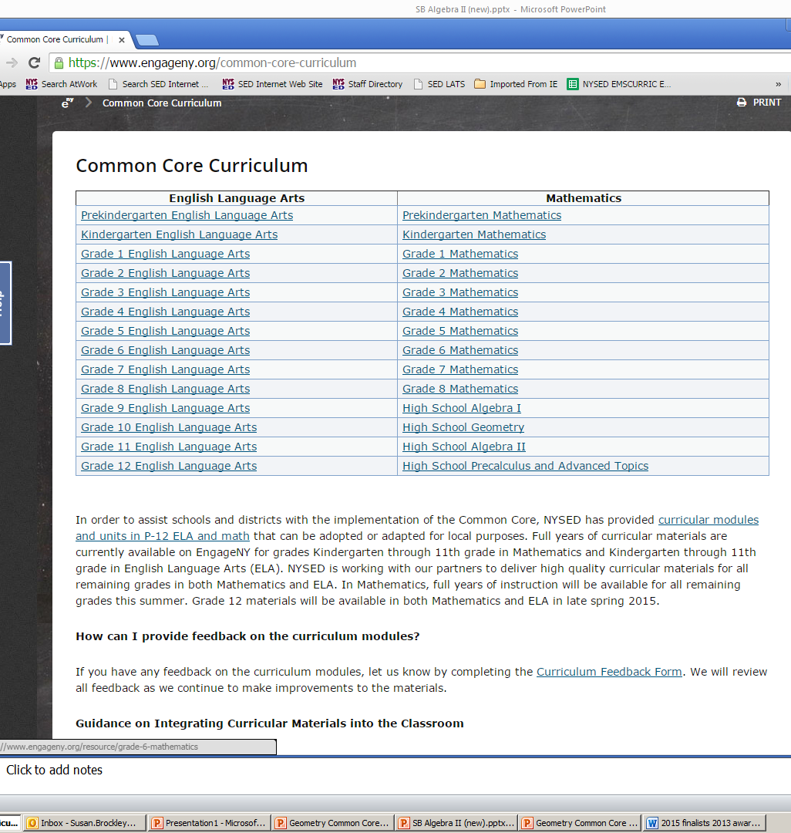
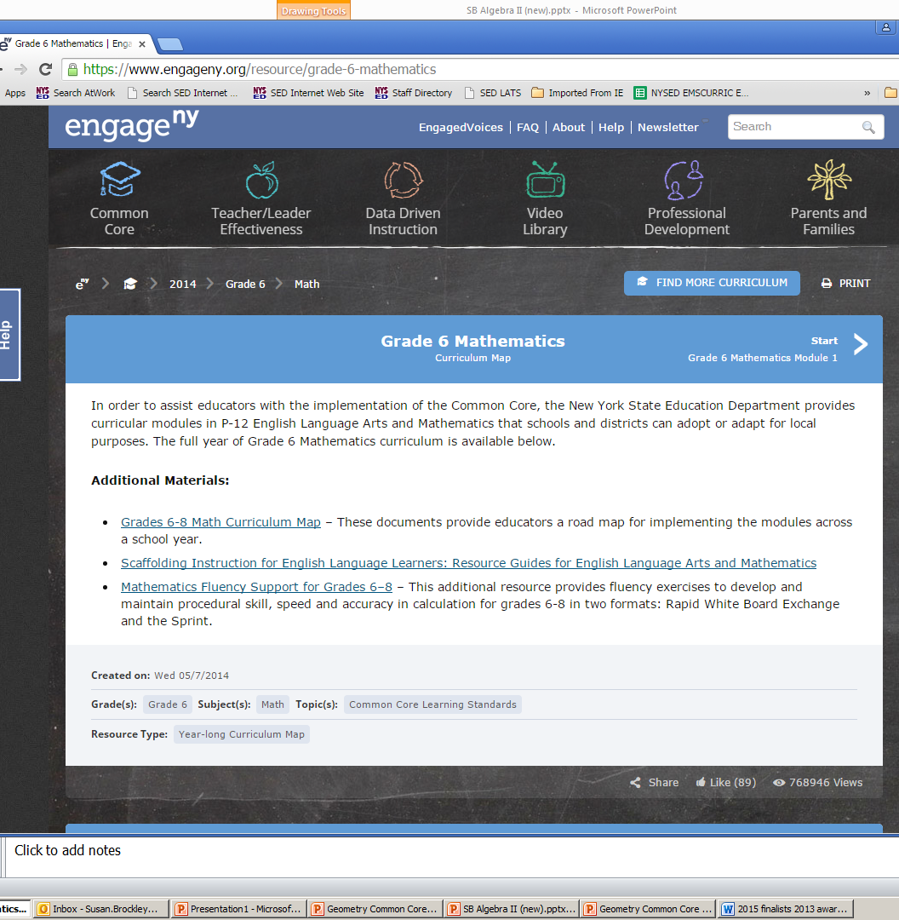
Fluency Supplement for Grades 6-8
Rapid White Board Exchanges
Sprints
Back

Slide 95
2015-2016 Award Cycle
K-6 Grade Level Teachers
Annually, New York State can recognize up to five Mathematics finalists and five Science finalists whose applications are then forwarded to a PAEMST Review and Selection Committee for the final determination of award winners from each state. Two finalists in Mathematics and/or Science from each state will be recognized as awardees at the national level.
What’ involved…
3 Letters of Recommendation
Resume
Narrative Component
Mastery of why content appropriate for grade level taught.
Use of instructional strategies and methods.
Effective use of assessments.
Reflective practice.
Leadership in Education outside of classroom.
45 minute Classroom Video of continuous lesson.
2016-2017
April 1, 2016
For more information about the PAEMST program visit the New York State’s Education Department’s website at http://www.p12.nysed.gov/ciai/mst/paemstaward.html
May 1, 2016
PAEMST NYSED Coordinators:
Math – Sue Brockley email: Susan.Brockley@nysed.gov
Science – Ann Crotty email: Ann.Crotty@nysed.gov
BACK

Slide 96
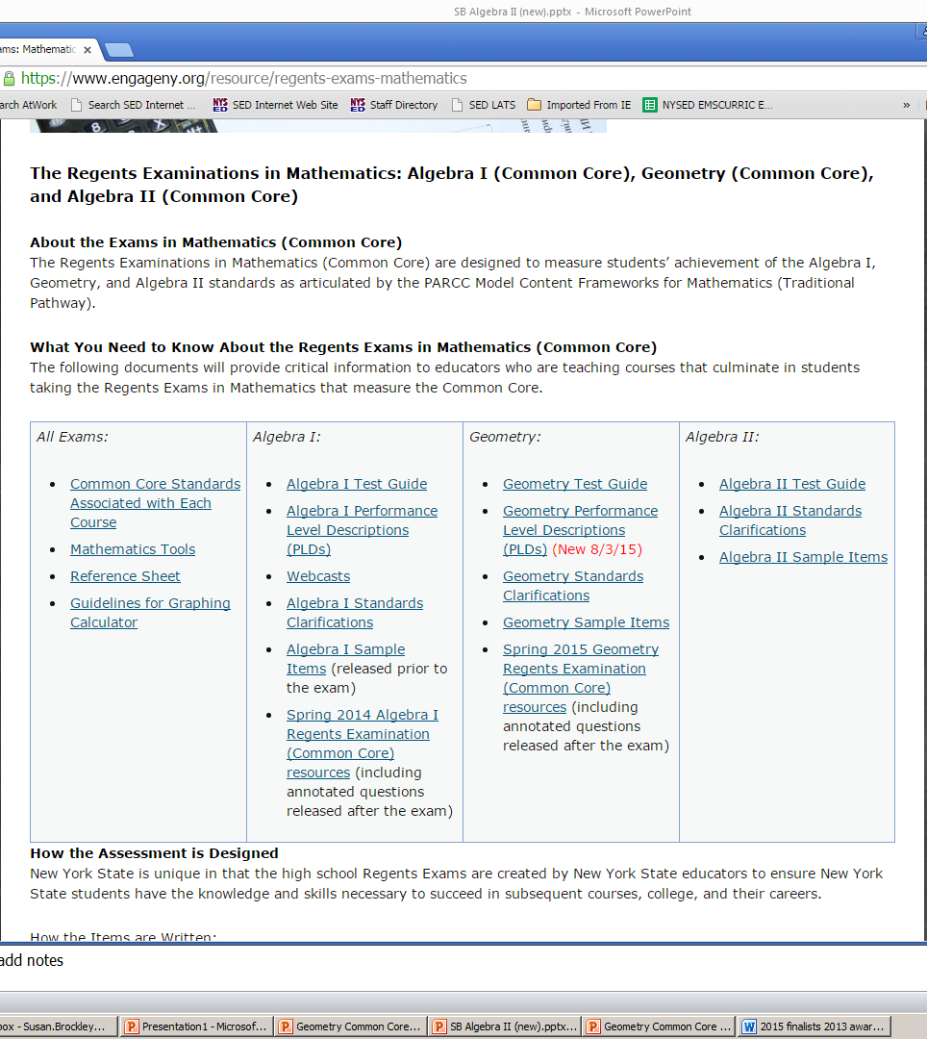
Performance Level Definitions
NYS Level 5
Students performing at this level exceed Common Core expectations.
NYS Level 4
Students performing at this level meet Common Core expectations.
NYS Level 3
Students performing at this level partially meet Common Core expectations (required for current
Regents Diploma purposes).
NYS Level 2 (Safety Net)
Students performing at this level partially meet Common Core expectations (required for Local Diploma
purposes).
NYS Level 1
Students performing at this level do not demonstrate the knowledge and skills required for NYS Level 2.
… used in Assessment
PLDs are essential in setting standards for the New York State Regents Examinations. Standard setting
panelists use PLDs to determine the threshold expectations for students to demonstrate the knowledge
and skills necessary to attain just barely a Level 2, Level 3, Level 4, or Level 5 on the assessment. These
discussions then influence the panelists in establishing the cut scores on the assessment. PLDs are also
used to inform item development, as each test needs questions that distinguish performance all along
the continuum.

Slide 97
… used in Instruction
PLDs help communicate to students, families, educators and the public the specific knowledge and skills expected of students to demonstrate proficiency and can serve a number of purposes in classroom instruction. They are the foundation of rich discussion around what students need to do to perform at
higher levels and to explain the progression of learning within a subject area.
BACK

Slide 98
Transition to Algebra II CC Regents Examination and access to
June 2016 Alg2/Trig Regents Examination
BACK
http://www.p12.nysed.gov/assessment/commoncore/transitiontoccregentsalgebraII815.pdf

Slide 99
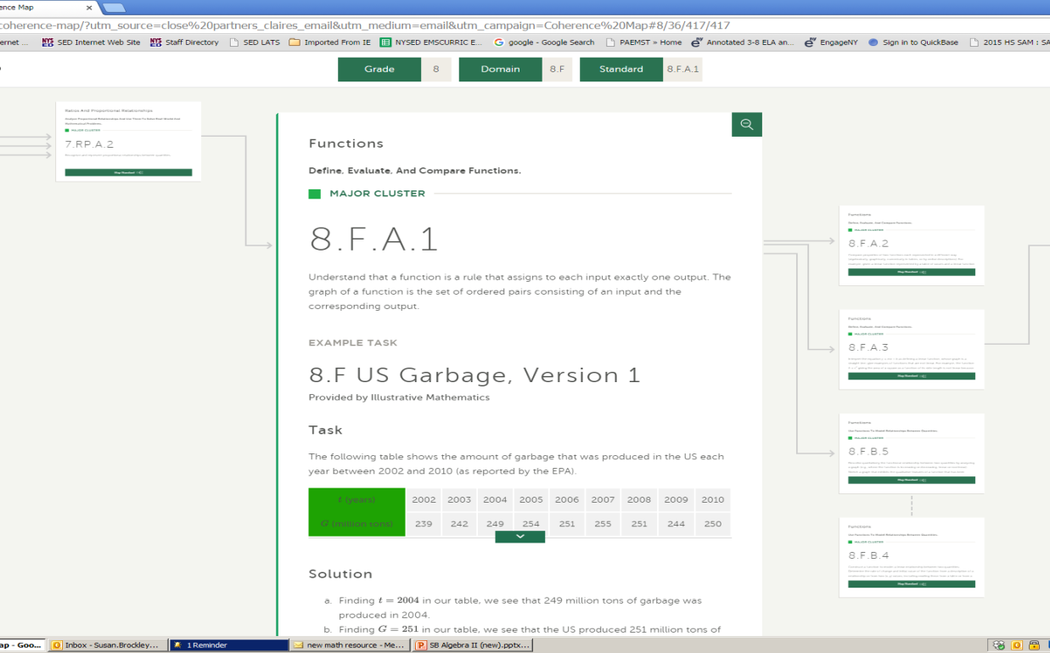
Student Achievement Partners: Achieve the Core
The Coherence Map shows the connections between Common Core State Standards for Mathematics.
Standards are illustrated with tasks, lessons, and assessments, as well as excerpts from the Progressions documents.
http://achievethecore.org/coherence-map/?utm_source=close%20partners_claires_email&utm_medium=email&utm_campaign=Coherence%20Map
http://achievethecore.org/page/858/annotated-mini-assessments
Annotated Mini-Assessments
BACK

Slide 100
Algebra II Assessment

Slide 101
Algebra II Assessment

Slide 102
Algebra II Assessment

Slide 103
Algebra II Assessment

Slide 104
Algebra II Assessment

Slide 105
Algebra II Assessment
How in depth do we need to go teaching AII CC topics?
How in depth do student explanations need to go to receive full credit?
Can the A2 CC exam be pushed to later in June?
BACK

